Slide 1

UNIVERSITY INSTITUTE OF ENGINEERING
COMPUTER SCIENCE ENGINEERING
Bachelor of Engineering (Computer Science & Engineering)
Subject Name: Big Data Analytics
Subject Code: 20CST-471
Transform, Load (ETL) processes
Mapped with CO3
Prepared By:
Er. Ankita Sharma
DISCOVER . LEARN . EMPOWER

Slide 2
Transform, Load (ETL) processes
ETL processes are a critical component in the data integration pipeline, playing a central role in preparing and transforming raw data from diverse sources into a format suitable for storage, analysis, and reporting.
The acronym ETL refers to the three key stages involved in this process: Extract, Transform, and Load.

Slide 3
Extract:
Definition: The extraction phase involves retrieving data from various source systems, which can include databases, applications, flat files, APIs, and more.
Methods: Extraction methods depend on the source system's capabilities and requirements. It may involve full extraction of the entire dataset or incremental extraction to capture changes since the last extraction.
Challenges: Challenges in extraction include dealing with different data formats, heterogeneous structures, and ensuring data consistency and integrity during extraction.

Slide 4
Transform:
Definition: Transformation is the process of cleaning, converting, and restructuring the extracted data to meet the needs of the target system, such as a data warehouse or analytical database.
Tasks: Transformation tasks include data cleaning, validation, enrichment, aggregation, and applying business rules. This phase is crucial for ensuring data quality and consistency across diverse sources.
Tools: ETL tools, ranging from open-source solutions like Apache NiFi to commercial platforms like Informatica and Microsoft SSIS, are often employed to automate and streamline the transformation process.

Slide 5
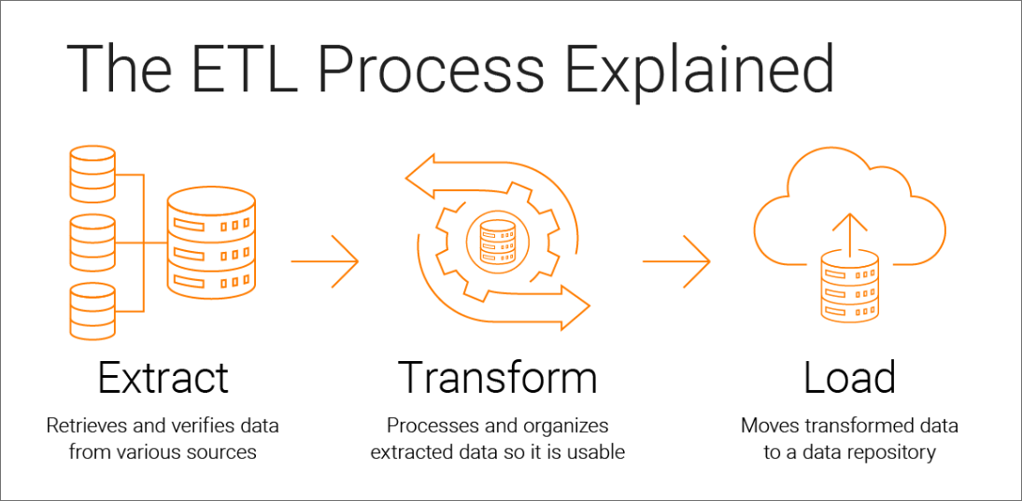

Slide 6
Load:
Definition: The loading phase involves inserting the transformed data into the target system, whether it's a data warehouse, data mart, or another storage solution.
Strategies: Loading strategies may include bulk loading for efficiency or incremental loading to update only the changed or new data. This step aims to optimize performance and ensure the data is available for analysis in a timely manner.
Validation: Data integrity checks and validations are performed during the loading phase to ensure that the data meets the quality standards set by the organization.

Slide 7
Key Considerations in ETL Processes:
Scalability:
ETL processes must be scalable to handle increasing volumes of data as organizations grow and accumulate more information.
Flexibility:
The ETL system should be flexible enough to accommodate changes in source systems, data structures, and business requirements without significant disruptions.
Timeliness:
ETL processes should be designed to provide timely updates to the target system, ensuring that analytical insights are based on the most recent information available.

Slide 8
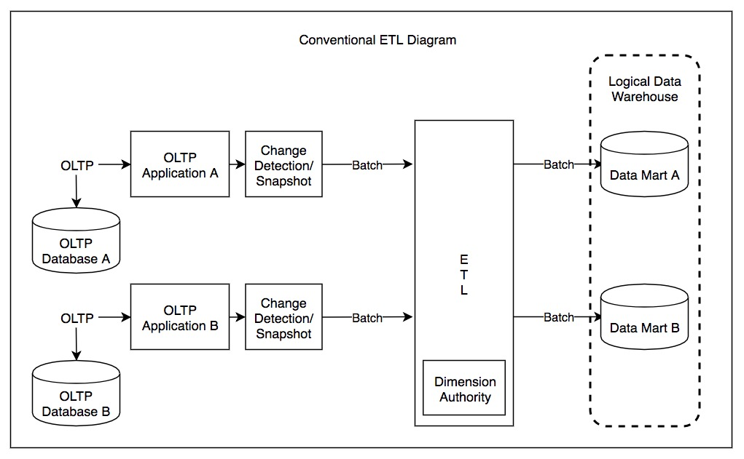

Slide 9
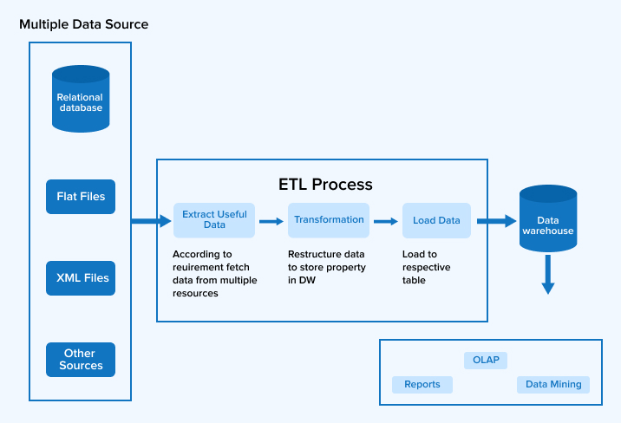

Slide 10
Thankyou

